Slide 1
Big Data
Hive Basics
LEVEL – PRACTITIONER

Slide 2
Madhura Verma
PA-Big Data
1.0

Slide 3









Icons Used
Hands on Exercise
Questions
Tools
Coding Standards
Test Your Understanding
Case Study
Best Practices & Industry Standards
Demonstration
Workshop

Slide 4
Overview
This chapter will cover the concepts of Hive and the Hive Query Language in detail.

Slide 5
Objectives
After completing this chapter you will be able to:
Describe what is Hive
Describe Hive Features
Describe Hive Architecture
Describe Hive Working
Explain interaction of Hive with Hadoop
Describe Data Types in Hive
Explain Hive Query Language
Describe Data Models in Hive
Explain Partitioning, Bucketing, Views and Indexes
Describe Hive UDFs

Slide 6
HIVE INTRODUCTION

Slide 7

What is HIVE?
Hive is a data warehouse infrastructure tool to process structured data in Hadoop.
Resides on top of Hadoop.
Initially Hive was developed by Facebook, later the Apache Software Foundation took it up and developed it further as an open source under the name Apache Hive.

Slide 8
Why another Data Warehousing System
Problem : Data, data and more data
Several TBs of data everyday
The Hadoop Experiment:
Uses Hadoop File System (HDFS)
Scalable/Available
Problem
Lacked Expressiveness
Map-Reduce hard to program
Solution : HIVE

Slide 9
Features of Hive
Stores schema in a database and processed data into HDFS.
Designed for OLAP.
It provides SQL type language for querying called HiveQL or HQL.
It is familiar, fast, scalable, and extensible.
Indexing to provide acceleration, index type including compaction and Bitmap index as of 0.10, more index types are planned.
Different storage types such as plain text, RCFile, HBase, ORC, and others.

Slide 10
Features of Hive
Metadata storage in an RDBMS, significantly reducing the time to perform semantic checks during query execution.
Operating on compressed data stored into the Hadoop ecosystem using algorithms including DEFLATE,BWT, Snappy, etc.
Built-in user defined functions (UDFs) to manipulate dates, strings, and other data-mining tools. Hive supports extending the UDF set to handle use-cases not supported by built-in functions.
SQL-like queries (HiveQL), which are implicitly converted into MapReduce or Tez jobs

Slide 11
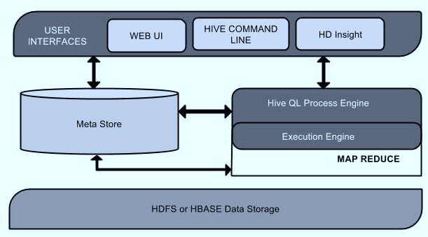
Architecture of Hive

Slide 12
Architecture of Hive - Explanation
Unit Name | Operation
User Interface | Hive is a data warehouse infrastructure software that can create interaction between user and HDFS. The user interfaces that Hive supports are Hive Web UI, Hive command line, and Hive HD Insight (In Windows server).
Meta Store | Hive chooses respective database servers to store the schema or Metadata of tables, databases, columns in a table, their data types, and HDFS mapping.
HiveQL Process Engine | HiveQL is similar to SQL for querying on schema info on the Metastore. It is one of the replacements of traditional approach for MapReduce program. Instead of writing MapReduce program in Java, we can write a query for MapReduce job and process it.

Slide 13
Architecture of Hive - Explanation
Unit Name | Operation
Execution Engine | The conjunction part of HiveQL process Engine and MapReduce is Hive Execution Engine. Execution engine processes the query and generates results as same as MapReduce results. It uses the flavor of MapReduce.
HDFS or HBASE | Hadoop distributed file system or HBASE are the data storage techniques to store data into file system

Slide 14
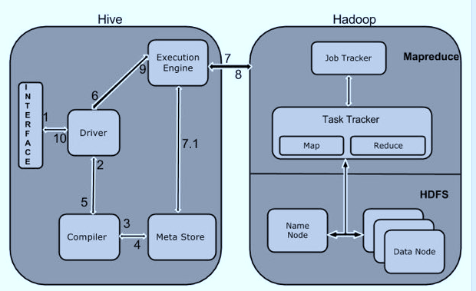
Working of Hive

Slide 15
Hive Interaction with Hadoop
Step No | Operation
1 | Execute Query - The Hive interface such as Command Line or Web UI sends query to Driver (any database driver such as JDBC, ODBC, etc.) to execute
2 | Get Plan - The driver takes the help of query compiler that parses the query to check the syntax and query plan or the requirement of query.
3 | Get Metadata - The compiler sends metadata request to Metastore (any database).
4 | Send Metadata - Metastore sends metadata as a response to the compiler.
5 | Send Plan - The compiler checks the requirement and resends the plan to the driver. Up to here, the parsing and compiling of a query is complete.

Slide 16
Hive Interaction with Hadoop
Step No | Operation
6 | Execute Plan - The driver sends the execute plan to the execution engine.
7 | Execute Job - Internally, the process of execution job is a MapReduce job. The execution engine sends the job to JobTracker, which is in Name node and it assigns this job to TaskTracker, which is in Data node. Here, the query executes MapReduce job.
7.1 | Metadata Ops - Meanwhile in execution, the execution engine can execute metadata operations with Metastore.
8 | Fetch Result - The execution engine receives the results from Data nodes.
9 | Send Results - The execution engine sends those resultant values to the driver
10 | Send Results - The driver sends the results to Hive Interfaces.

Slide 17
Test Your Understanding
What is the need for Hive?
What are the components of Hive Architecture?

Slide 18
HIVE DATA TYPES

Slide 19
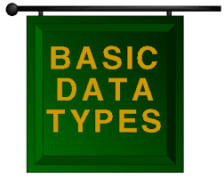
Data Types
Data types in Hive are classified into four types :
Column Types
Literals
Null Values
Complex Types

Slide 20
Column Types
Integral Types : TINYINT, SMALLINT, INT, BIGINT.
String Types : VARCHAR , CHAR.
Timestamp : supports java.sql.Timestamp format “YYYY-MM-DD HH:MM:SS.fffffffff” and format “yyyy-mm-dd hh:mm:ss.ffffffffff”.
Dates : {{YYYY-MM-DD}}.
Decimals : Same as Big Decimal format of Java

Slide 21
Union Types, Literals and Null Value
Union Types
Union is a collection of heterogeneous data types.
Syntax : UNIONTYPE<int, double, array<string>, struct<a:int,b:string>>
Literals
Floating point types
Decimal Type
Null Value
Missing values are represented by the special value NULL.

Slide 22
Complex Types
Arrays
Arrays in Hive are used the same way they are used in Java.
Syntax: ARRAY<data_type>
Maps
Maps in Hive are similar to Java Maps.
Syntax: MAP<primitive_type, data_type>
Structs
Structs in Hive is similar to using complex data with comment.
Syntax: STRUCT<col_name : data_type [COMMENT col_comment], ...>

Slide 23
Hive Query Language

Slide 24
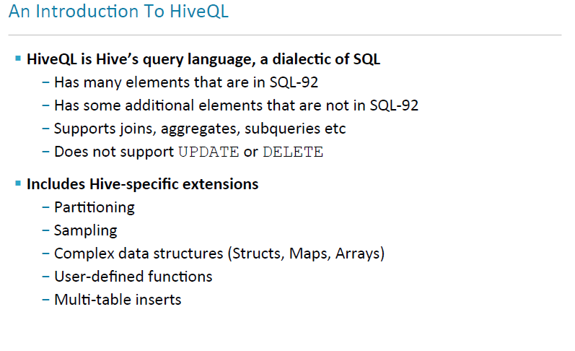

Slide 25
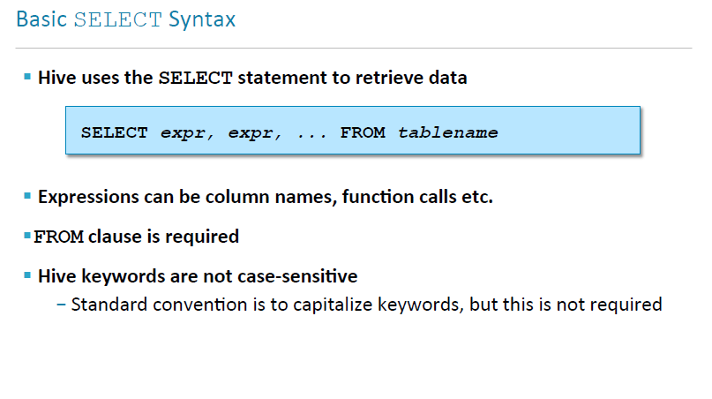

Slide 26
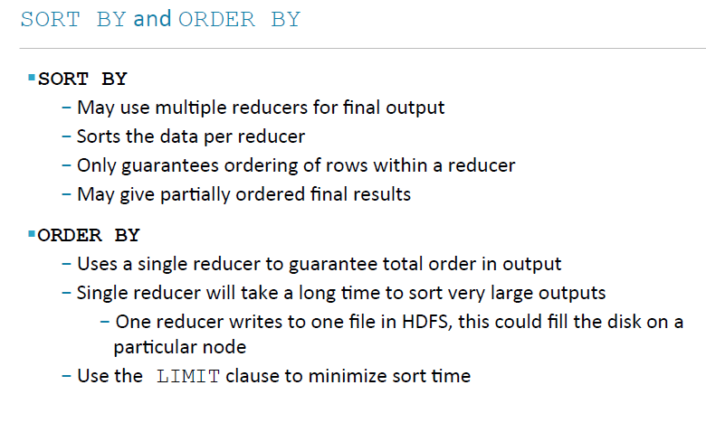

Slide 27
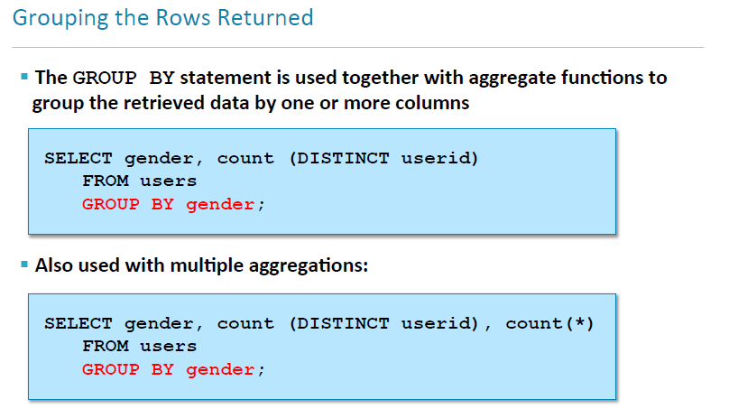

Slide 28
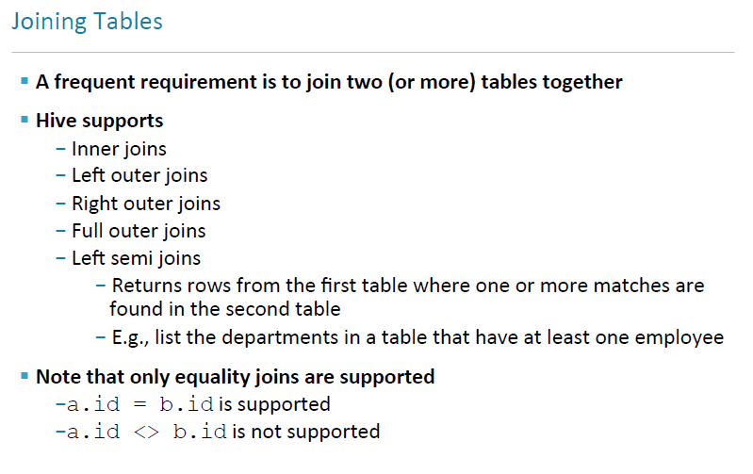

Slide 29
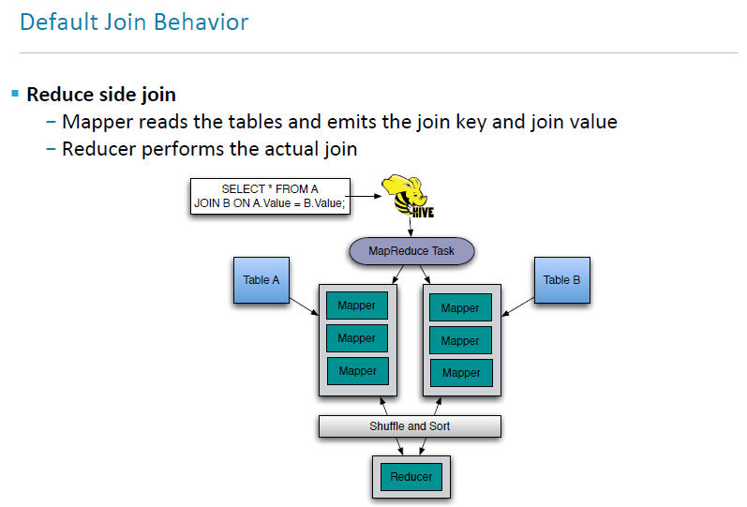

Slide 30
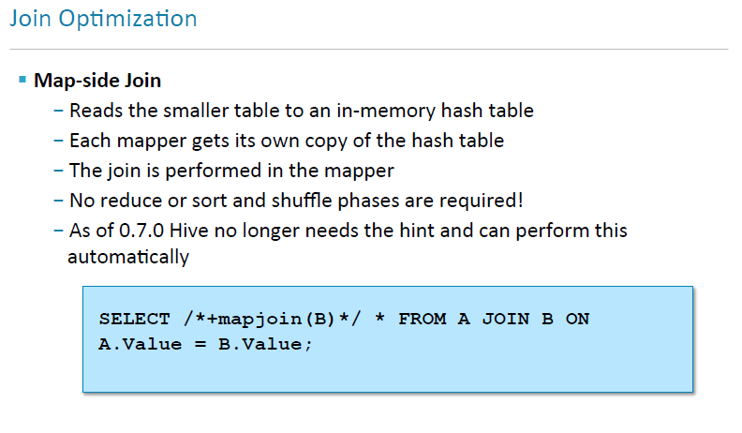

Slide 31
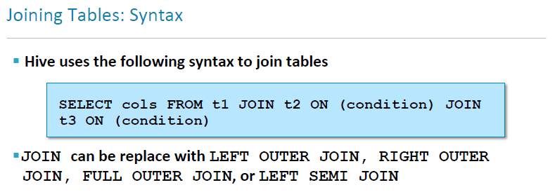

Slide 32
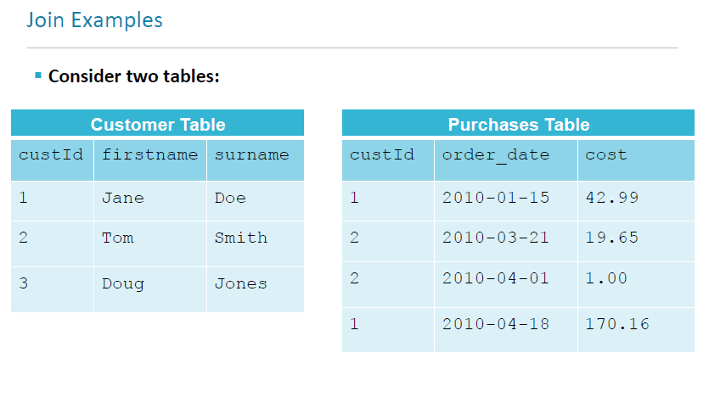

Slide 33
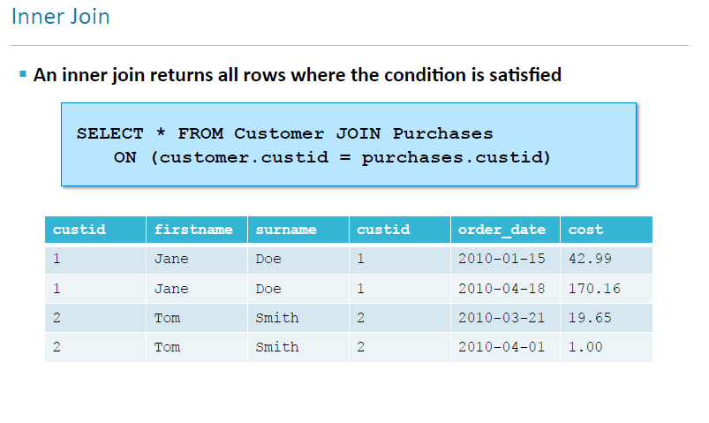

Slide 34
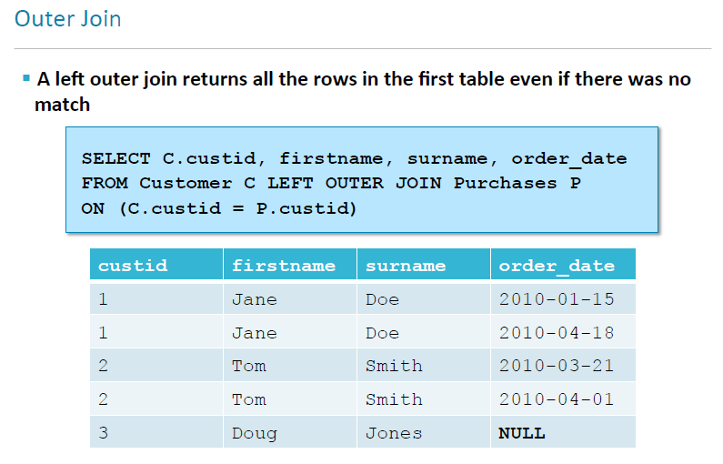

Slide 35
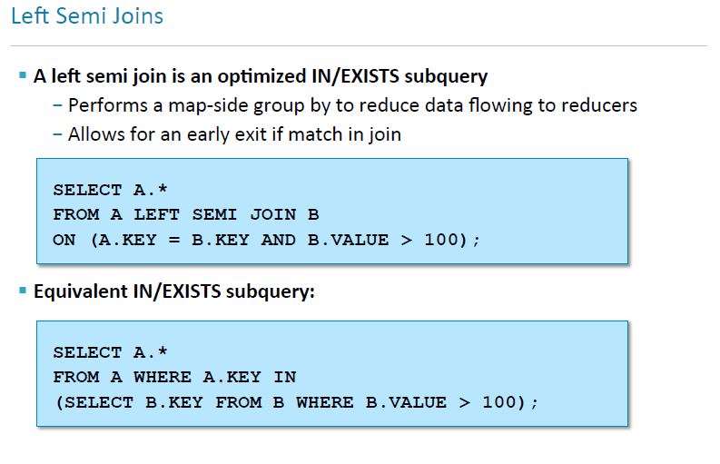

Slide 36
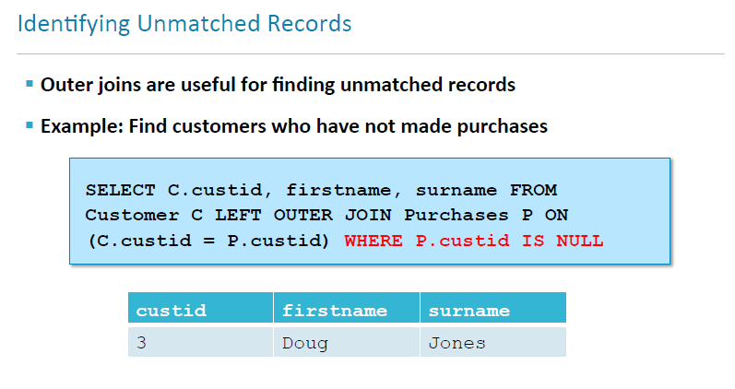

Slide 37
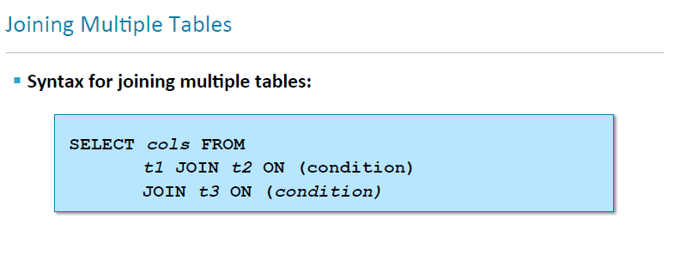

Slide 38
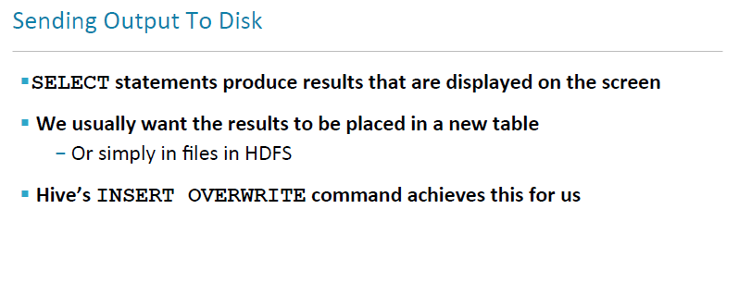

Slide 39
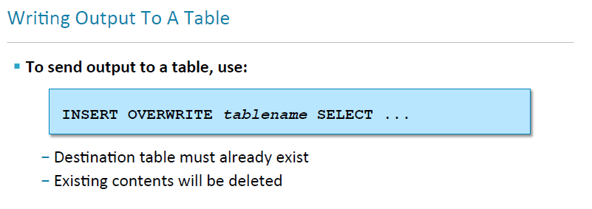

Slide 40
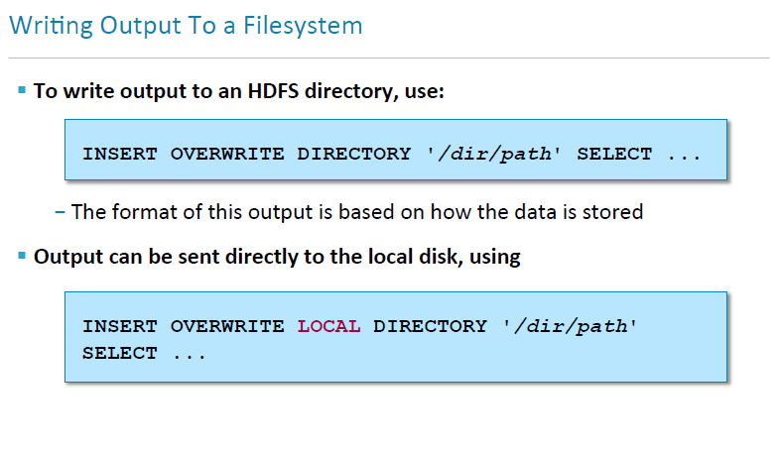

Slide 41
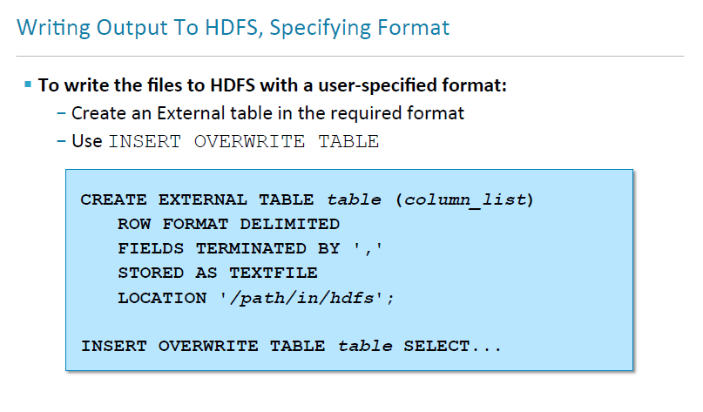

Slide 42
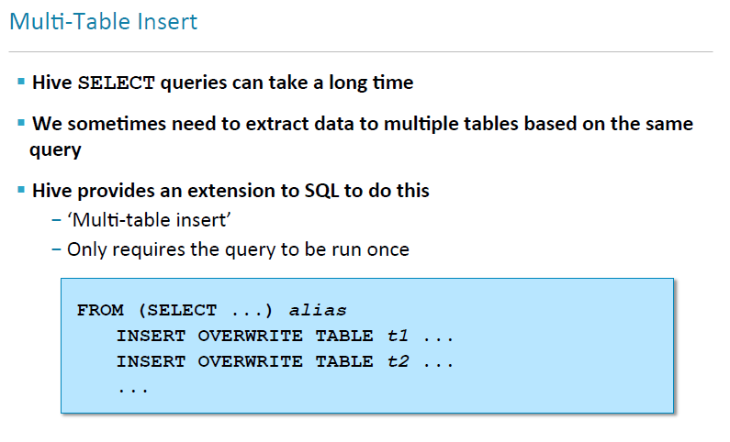

Slide 43
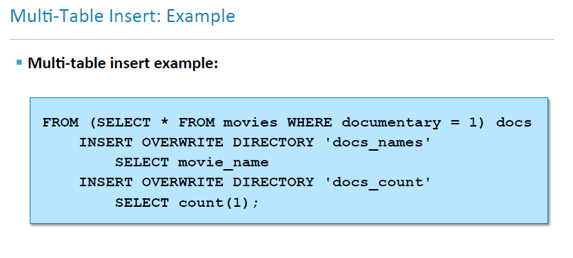

Slide 44
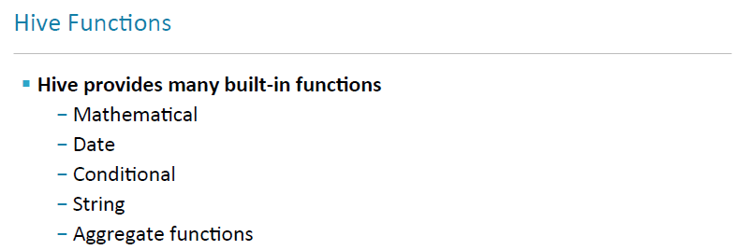

Slide 45
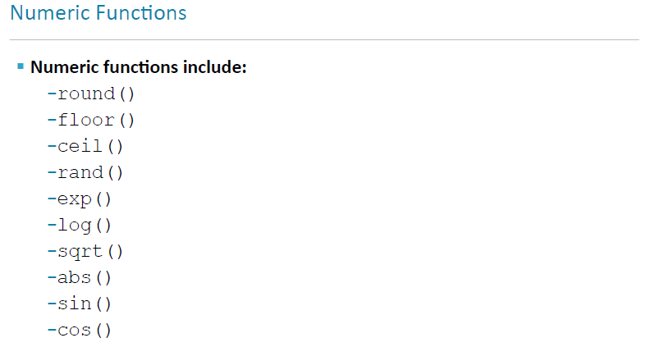

Slide 46
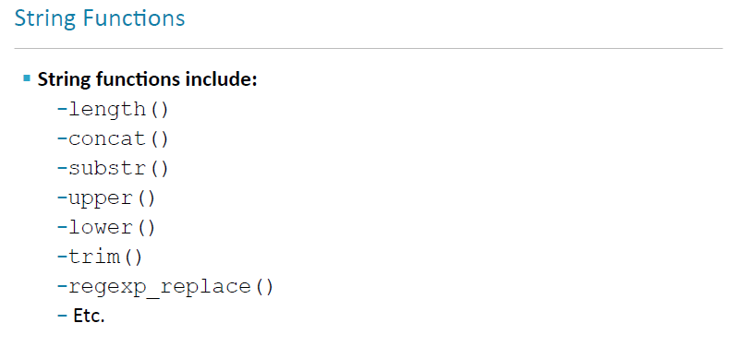

Slide 47
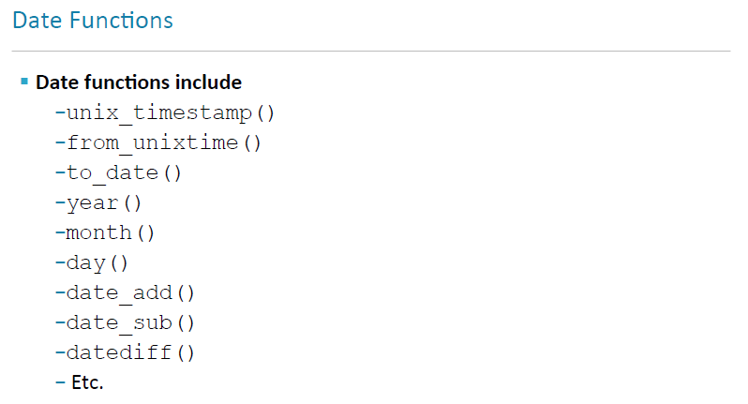

Slide 48
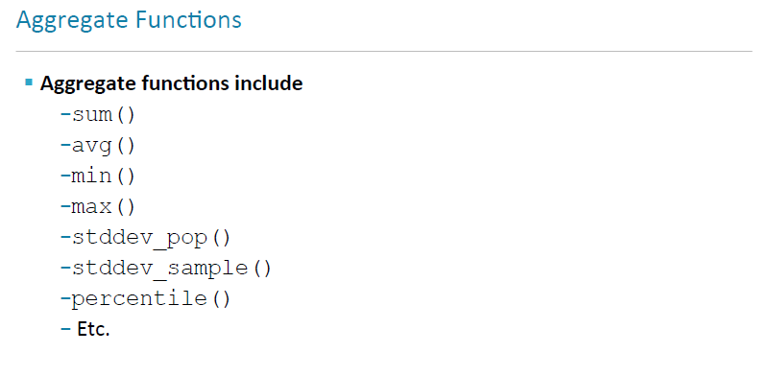

Slide 49
HIVE DATA MODEL

Slide 50

Data Model
Managed Table
External Table

Slide 51
External Tables
Point to existing data directories in HDFS.
Can create table and partitions
Data is assumed to be in Hive-compatible format
Dropping external table drops only the metadata
Example: create external table
CREATE EXTERNAL TABLE test_extern(c1 string, c2 int) ROW FORMAT DELIMITED FIELDS TERMINATED BY ‘,’
STORED AS TEXTFILE LOCATION '/user/mytables/mydata';

Slide 52
Managed Tables
Schema on read and load complete file as it is, without any parsing or modification to hive data warehouse directory.
Schema information would be saved in hive metastore for later operational use.
During drop table it drop data file from warehouse directory as well as schema from metastore
CREATE TABLE invites (foo INT, bar STRING ) ROW FORMAT DELIMITED FIELDS TERMINATED BY ‘,’
STORED AS TEXTFILE ;

Slide 53
Loading Files
Hive does not do any transformation while loading data into tables.
Load operations are currently pure copy/move operations that move data files into locations corresponding to Hive tables.
LOAD DATA [LOCAL] INPATH 'filepath' [OVERWRITE] INTO TABLE tablename

Slide 54
Partitioning

Slide 55
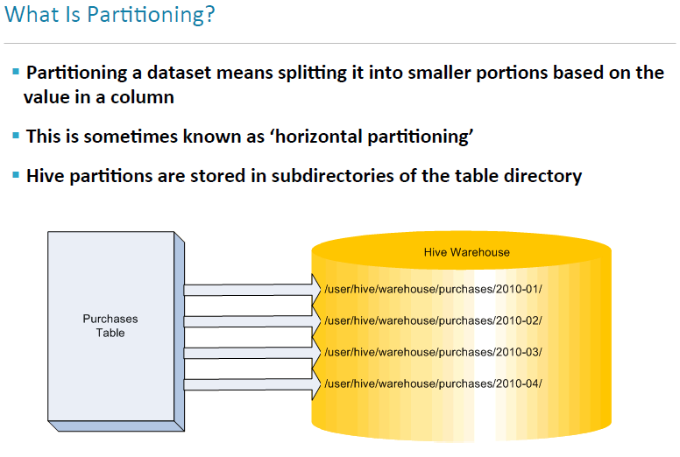

Slide 56
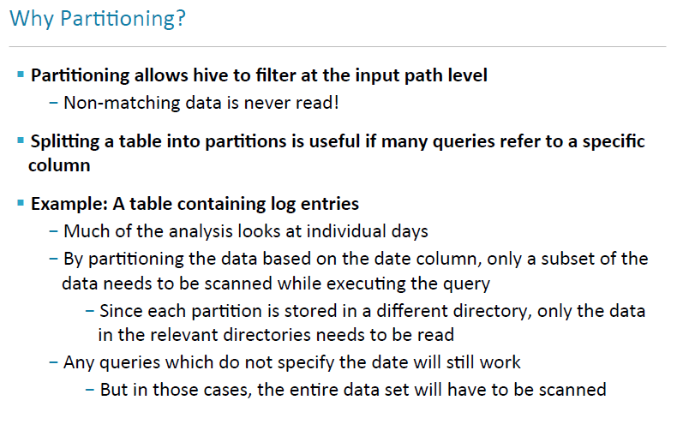

Slide 57
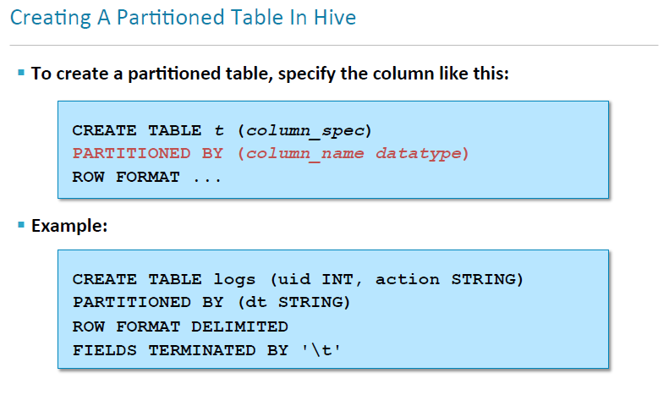

Slide 58
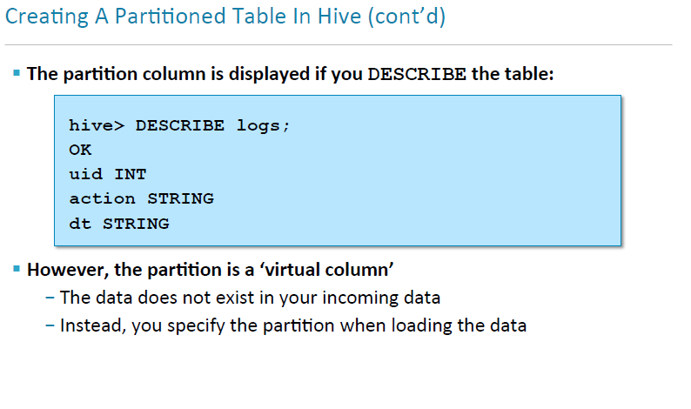

Slide 59
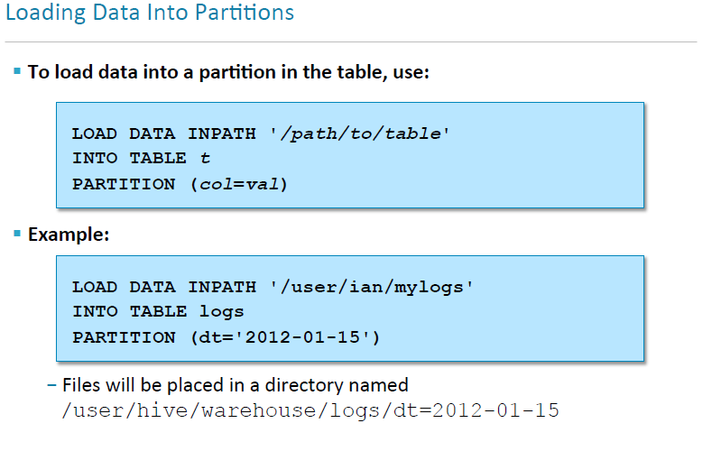

Slide 60
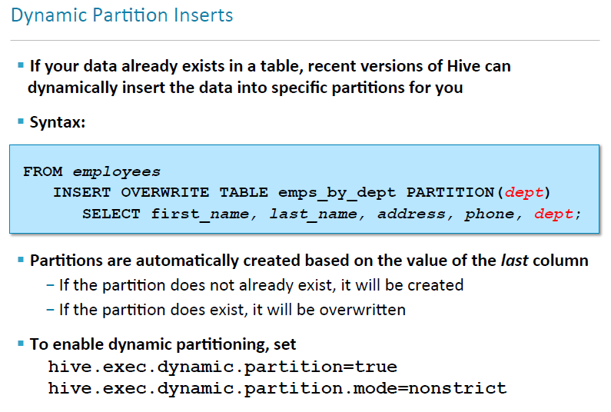

Slide 61
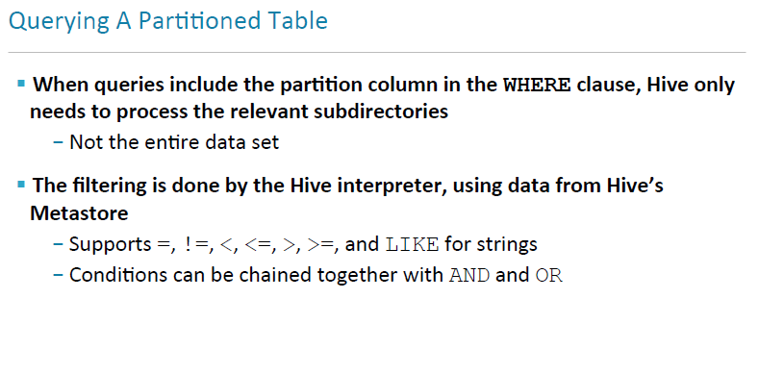

Slide 62
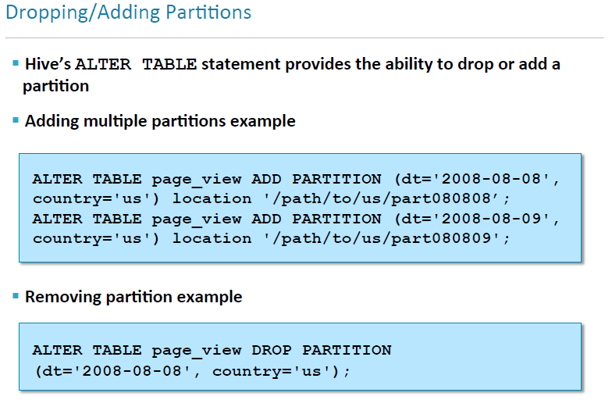

Slide 63
Bucketing

Slide 64
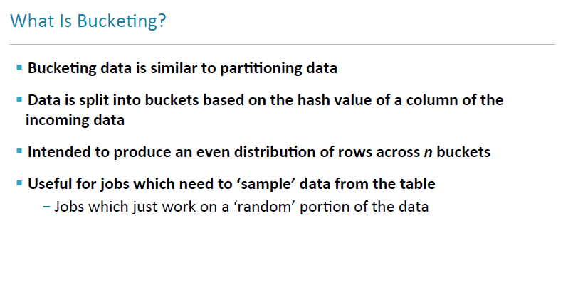

Slide 65
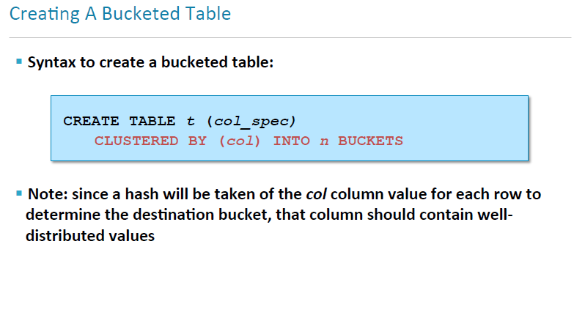

Slide 66
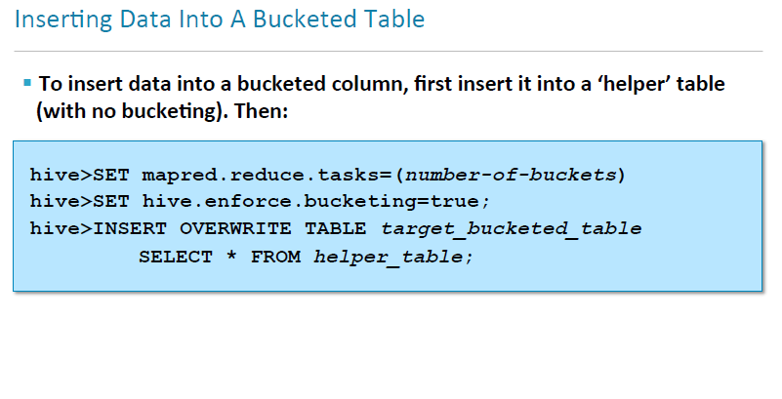

Slide 67
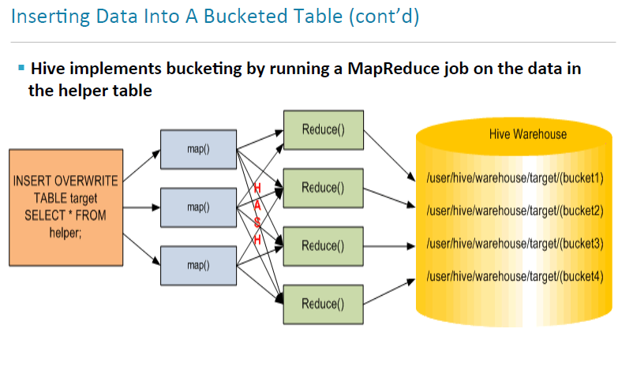

Slide 68
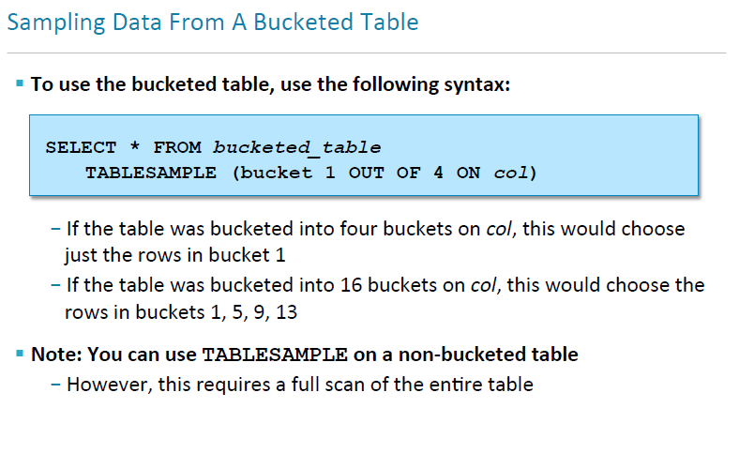

Slide 69
Views

Slide 70
What are Views?
When a query becomes long or complicated, a view may be used to hide the complexity by dividing the query into smaller, more manageable pieces
Views are generated based on user requirements and can save any result set data as a view.
The usage of view in Hive is same as that of the view in SQL and It is a standard RDBMS concept.
hive> CREATE VIEW <view_name> AS SELECT * from <table name>;
hive> DROP VIEW <view_name>;

Slide 71
For example, consider the following query with a nested sub query:
FROM (
SELECT * FROM people JOIN cart
ON (cart.people_id=people.id) WHERE firstname='john'
) a SELECT a.lastname WHERE a.id=3;
It is common for Hive queries to have many levels of nesting. In the following example, the nested portion of the query is turned into a view:
CREATE VIEW shorter_join AS
SELECT * FROM people JOIN cart
ON (cart.people_id=people.id) WHERE firstname='john';
Now the view is used like any other table. In this query we added a WHERE clause to the SELECT statement. This exactly emulates the original query:
SELECT lastname FROM shorter_join WHERE id=3;

Slide 72
Indexing

Slide 73
What is Indexing?
An Index is nothing but a pointer on a particular column of a table.
Creating an index means creating a pointer on a particular column of a table.
Indexing is also a good alternative to partitioning when the logical partitions would actually be too numerous and small to be useful.
Maintaining an index requires extra disk space and building an index has a processing cost. The user must weigh these costs against the benefits they offer when querying a table.
The EXPLAIN syntax and Hive can be used to determine if a given query is aided by an index.

Slide 74
Syntax for creating Index
CREATE INDEX index_name ON TABLE base_table_name (col_name, ...) AS 'index.handler.class.name' [WITH DEFERRED REBUILD] [IDXPROPERTIES (property_name=property_value, ...)] [IN TABLE index_table_name] [PARTITIONED BY (col_name, ...)] [ [ ROW FORMAT ...] STORED AS ... | STORED BY ... ] [LOCATION hdfs_path] [TBLPROPERTIES (...)]
Example
hive> CREATE INDEX inedx_salary ON TABLE employee(salary) AS 'org.apache.hadoop.hive.ql.index.compact.CompactIndexHandler';
Syntax for Droping Index
DROP INDEX <index_name> ON <table_name>
Example
hive> DROP INDEX index_salary ON employee;

Slide 75
Hive UDFs

Slide 76
What is UDF?
Sometimes the query you want to write can’t be expressed easily using the
built-in functions that Hive provides.
By writing a user-defined function (UDF), Hive makes it easy to plug in your own processing code and invoke it from a Hive query.
There are three types of UDFs in Hive and they differ in the numbers of rows that they accept as input and produce as output:
UDF(user-defined function) operates on a single row and produces a single row as its output. Most functions, such as mathematical functions and string functions, are of this type.
UDAF (user-defined aggregate functions) works on multiple input rows and creates a single output row. Aggregate functions include such functions as COUNT and MAX.
UDTF (user-defined table-generating functions) operates on a single row and produces multiple rows a table as output.

Slide 77
Test Your Understanding
Why partitioning is needed?
How can you add data to a partition?
How to drop a partition?
What is bucketing?
What is the command to create index?
Describe UDF, UDAF and UDTF.

Slide 78
Summary
Apache Hive is a data warehouse infrastructure built on top of Hadoop for providing data summarization, query, and analysis.
Apache Hive supports analysis of large datasets stored in Hadoop's HDFS and compatible file systems .
All the data types in Hive are classified into four types, given as follows:
-Column Types
- Literals
- Null Values
-Complex Types
Hive provides indexing to provide acceleration.
Hive has built-in user defined functions (UDFs) to manipulate dates, strings, and other data-mining tools. Hive supports extending the UDF set to handle use-cases not supported by built-in functions.
Hive supports SQL-like queries (HiveQL).

Slide 79
Big Data
You have successfully completed –
Hive Basics Course

